Slide 1
Images in HTML

Slide 2
IMG tag
The HTML <img> tag is used to embed an image in a web page.
The <img> tag is empty, it contains attributes only, and does not have a closing tag.
This is a void element (meaning, it cannot have any child content and cannot have an end tag) that requires two attributes to be useful: src and alt.
The src attribute contains a URL pointing to the image you want to embed in the page.
The src attribute can be a relative URL or an absolute URL. Without a src attribute, an img element has no image to load.

Slide 3
So for example, if your image is called flower.jpg, and it sits in the same directory as your HTML page, you could embed the image like so:
<img src=“flower.jpg" alt=“flower" />

Slide 4
If the image was in an images subdirectory, which was inside the same directory as the HTML page, then you'd embed it like this:
<img src="images/flower.jpg" alt=“flower" />

Slide 5
You could also embed the image using its absolute URL, for example:
<img src="https://www.example.com/images/flower.jpg" alt="flower" />
It is more efficient to use relative URLs than absolute URLs in terms of maintenance (when you move your site to a different domain, you won't need to update all your URLs to include the new domain)

Slide 6
Alternative text
Its value is supposed to be a textual description of the image, for use in situations where the image cannot be seen/displayed or takes a long time to render because of a slow internet connection.
<img
src="images/flower.jpg"
alt=“Rose" />
What exactly should you write inside your alt attribute? It depends on why the image is there in the first place
The user is visually impaired, and is using a screen reader to read the web out to them. In fact, having alt text available to describe images is useful to most users.

Slide 7
Width and height attribute
You can use the width and height attributes to specify the width and height of your image. They are given as integers without a unit, and represent the image's width and height in pixels.
There's a very good reason to do this. The HTML for your page and the image are separate resources, fetched by the browser as separate HTTP(S) requests.
As soon as the browser has received the HTML, it will start to display it to the user.
If the images haven't yet been received (and this will often be the case, as image file sizes are often much larger than HTML files), then the browser will render only the HTML, and will update the page with the image as soon as it is received.

Slide 8
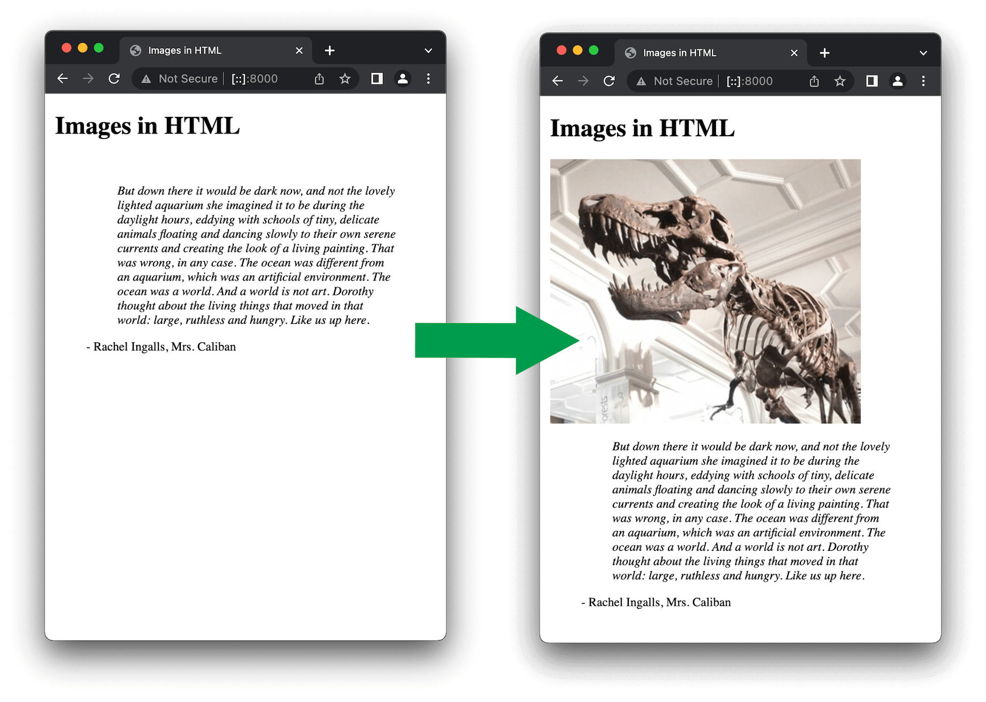
As soon as the browser downloads the HTML, the browser will start to display the page.
Once the image is loaded, the browser adds the image to the page. Because the image takes up space, the browser has to move the text down the page, to fit the image above it:

Slide 9
Moving the text like this is extremely distracting to users, especially if they have already started to read it.
If you specify the actual size of the image in your HTML, using the width and height attributes, then the browser knows, before it has downloaded the image, how much space it has to allow for it.
This means that when the image has been downloaded, the browser doesn't have to move the surrounding content.

Slide 10
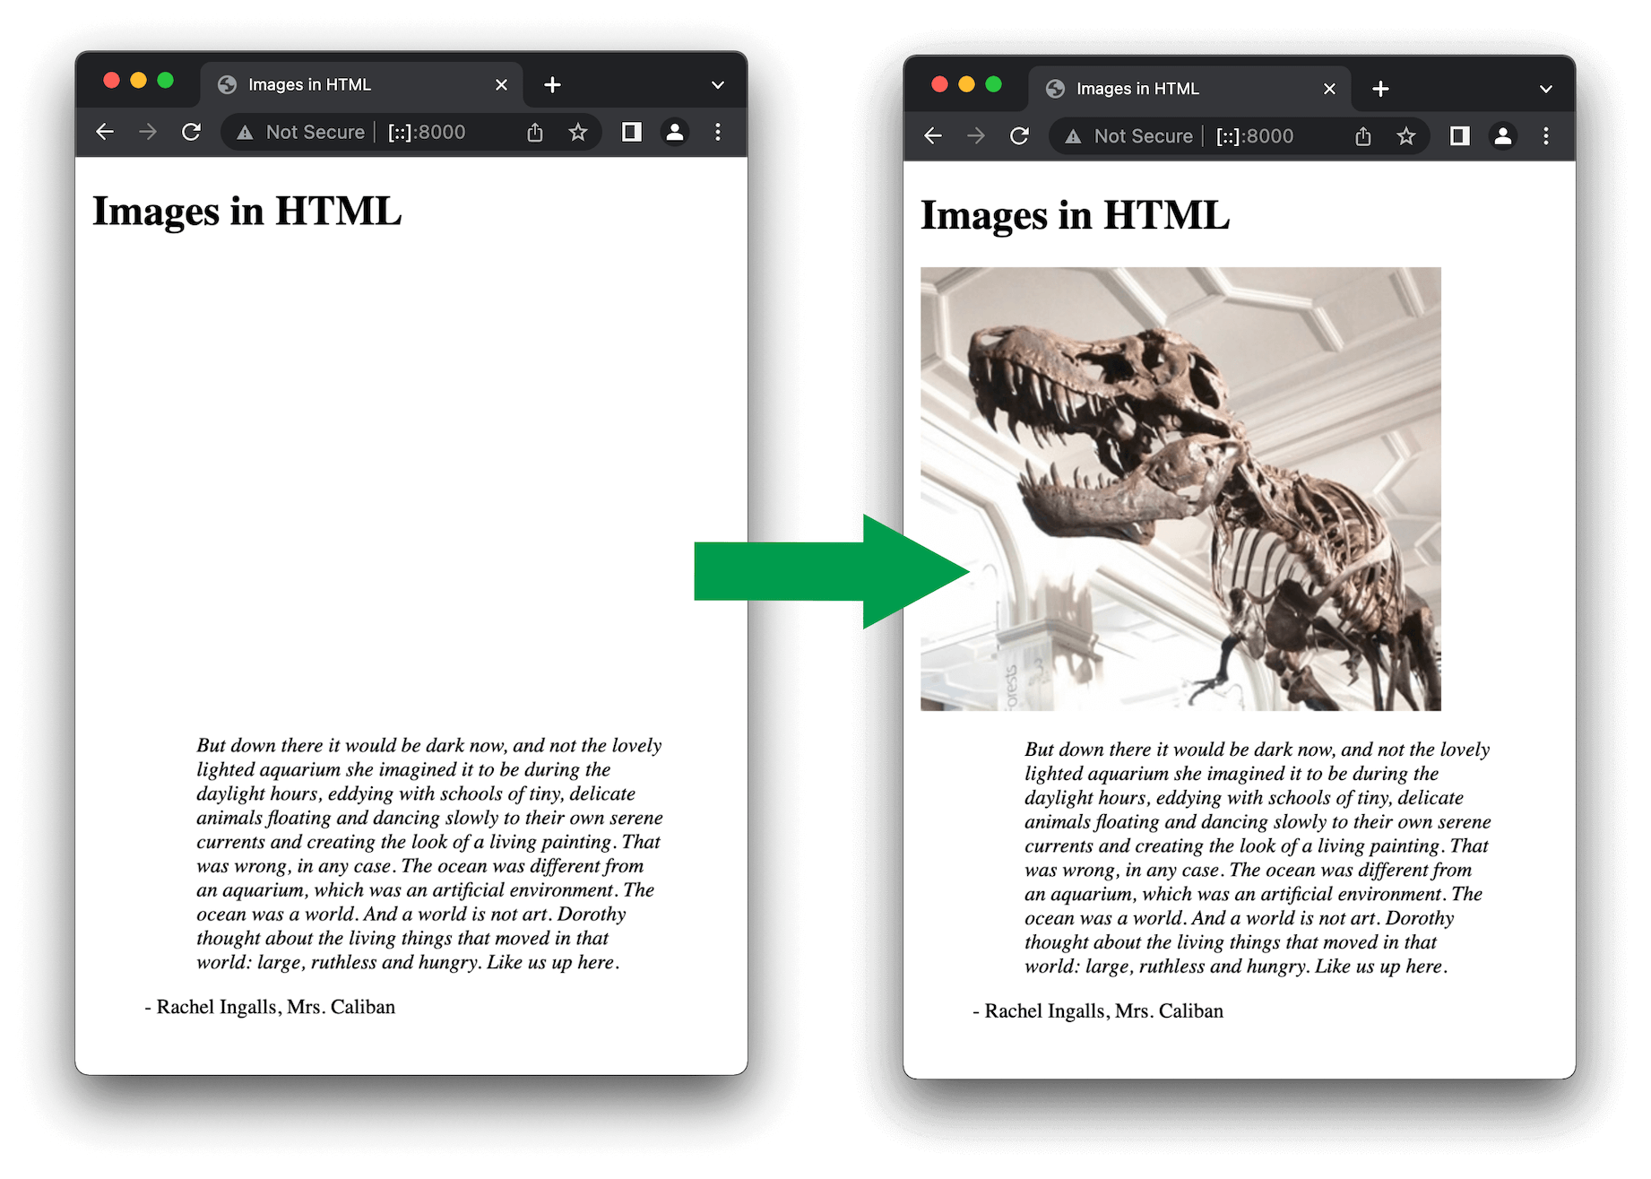

Slide 11
Creating hyperlinks in html

Slide 12
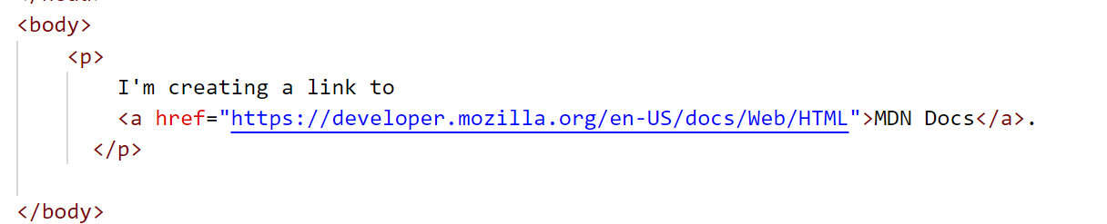
Hyperlink
Hyperlinks allow us to link documents to other documents or resources, link to specific parts of documents, or make apps available at a web address.
A basic link is created by wrapping the text or other content inside an <a> element and using the href attribute, also known as a Hypertext Reference, that contains the web address.

Slide 13
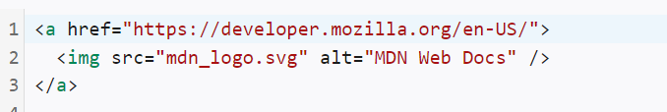
Image links
If you have an image you want to make into a link, use the <a> element to wrap the image file referenced with the <img> element.

Slide 14
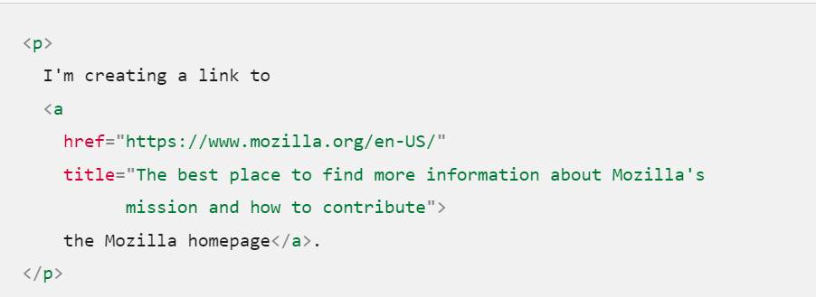
Title Attribute
The title contains additional information about the link, such as which kind of information the page contains.

Slide 15
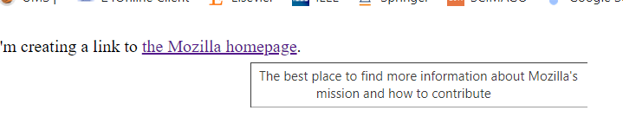

Slide 16
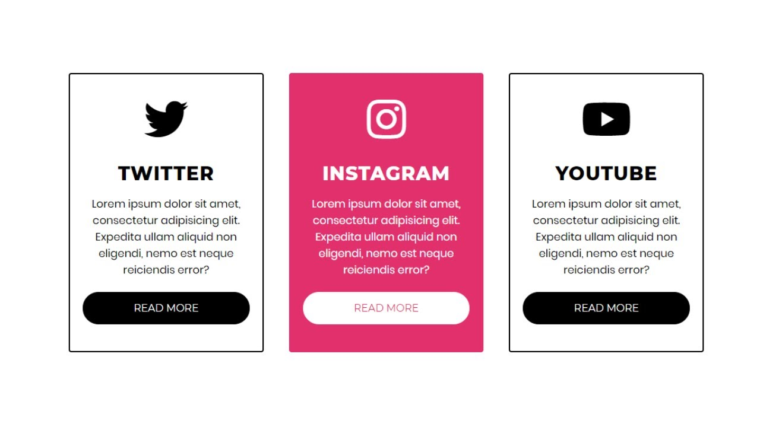
Try this💻💻💻
"Create an image gallery using cards for a flower shop. The gallery should include a header and main content. The main content must have
:An image of a flower, The flower's name, A description of the flower"

